Slide 1

Personal Augmented Reality for Information Visualization on Large Interactive Displays
Patrick Reipschlager, Tamara Flemisch, Raimund Dachselt
Bruno Assunção 89010
Rodrigo Ferreira 104737
Notes:
1

Slide 2
Why this paper?
AR is a topic of interest.
Relevant to information visualization.
Interesting approach to a common problema.

Slide 3
context
Large displays show great potential for interactive information visualization with large amounts of potentially multivariate data or visualizations.
Due to:
Screen size;
Physical space;
Various interaction modalities;
Facilitation of collaboration.
There are still some issues.
This paper tries to address them.

Slide 4
problems
Three types of problems arise from the use of large displays:
Perceptual issues;
Density and complexity management;
Multiple user support.

Slide 5
Perceptual issues
Change blindness;
Distortion due to viewing angles;
Physical navigation;
Effects of visual encodings;

Slide 6


Change blindness
Change blindness occurs in large displays due to the screen size, meaning that the display extends to peripheral vision.
Thus, making comparisons and having an overview of the data is much more difficult.
Motion and animation can be used to mitigate this, but while they do increase awareness, perception is still limited.
Users are forced to look at other parts of the screen and to lose focus, to see what changed.

Slide 7

Distortion due to viewing angles
Due to large displays’ screen size, extreme viewing angles often occur.
These often cause distortion of the shape and orientation of data marks, as well as the perception of aspect ratios and color encodings.
Some possible solutions have been used to tackle this, such as curved displays and images with multiple scales.

Slide 8
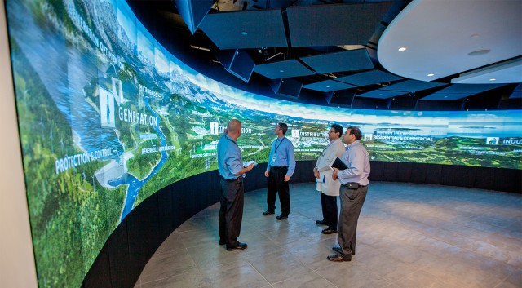
Physical navigation
Users move naturally when facing large displays.
This physical navigation improves performance over virtual navigation and increases spatial memory, but it also becomes a requirement.
But users are forced to:
Get closer to the display to get the details.
Step away from the display to get an overview.

Slide 9
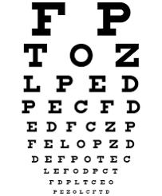
Effects of visual encodings
As mentioned, there is a necessity of moving away from the display to get an overview.
Perceptual issues emerge from that as visual encodings will be lost or perceived differently at a distance.
This can be mitigated with the use of visual aggregations with color (light and dark regions, for contrast). Another approach is adapting the information displayed according to the user’s proximity.

Slide 10
Density and complexity management
Appropriate use of space;
Scaling of visual encodings;
Overplotting;
Data complexity;

Slide 11
Appropriate use of space
Larger displays bring more space, and it is sometimes a challenge to use it well.
Decisions have to be made on how to increase the amount of information displayed.
The obvious answer is to simply increase the amount of data items but adding more data dimensions might result in more comprehensive visualizations.
Extra space might be used to display more visualizations, but for a big enough dataset, even large screens might not be enough.
Therefore, alternative ways of visualizing additional data should be considered instead of simply increasing the screen space.

Slide 12
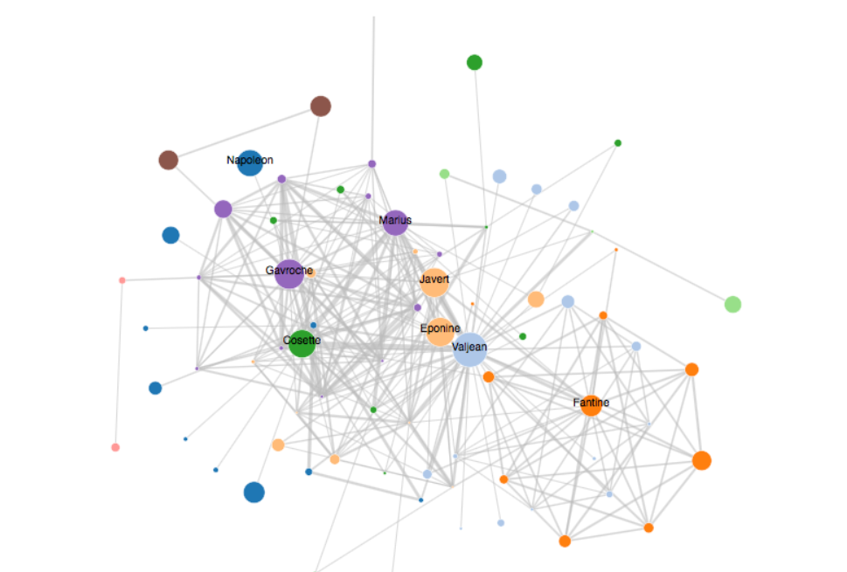
Scaling of visual encodings
Managing density and complexity of data is usually an issue for smaller screens with limited space, some issues remain for larger screens though.
Some visual encodings such as the number of data marks and their size and color, scale well and benefit from additional space.
Others like the number of perceivable colors and network connectivity (edge crossings) do not improve with additional space.

Slide 13
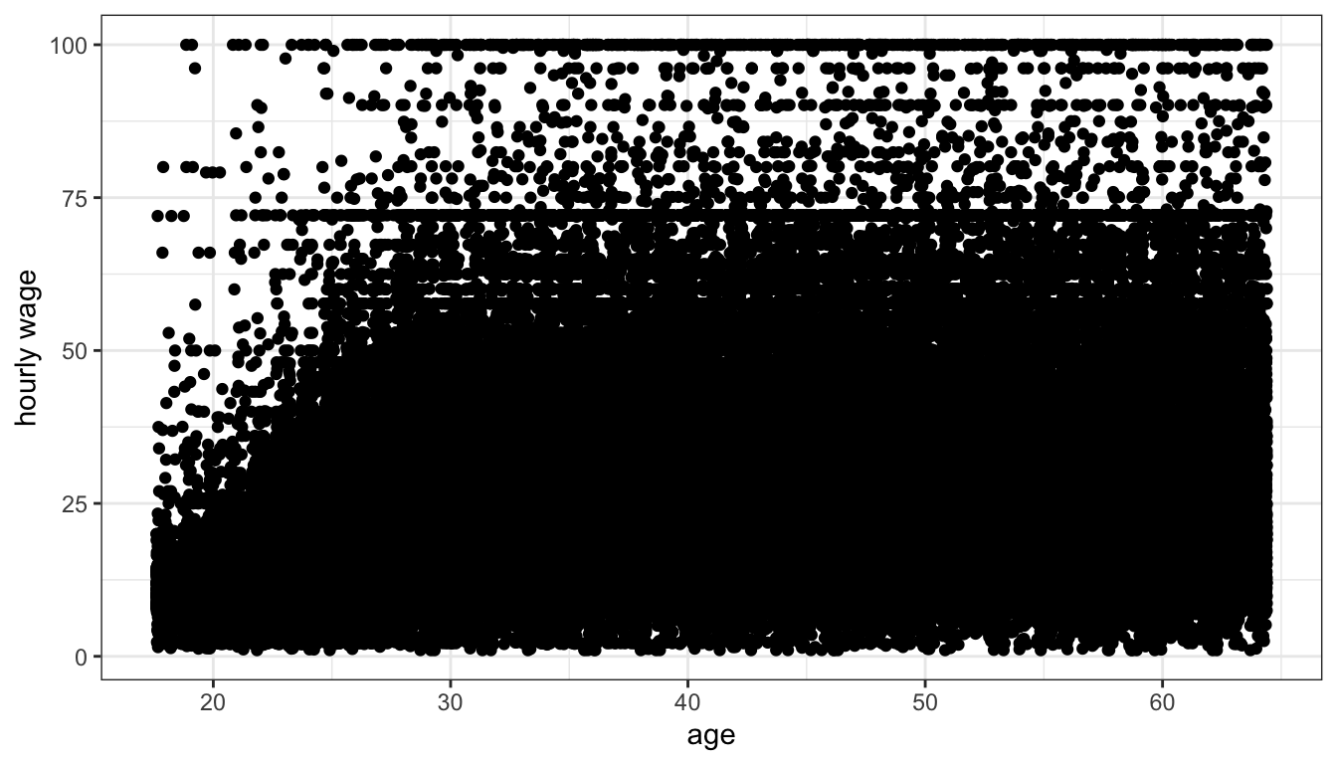
overplotting
Overplotting still occurs with larger displays.
Though there are some methods to mitigate it.
For example, there might be an option to zoom on a cluttered scatter plot, or edge bundling in dense node-link diagrams.
Decent solutions but not super effective.

Slide 14
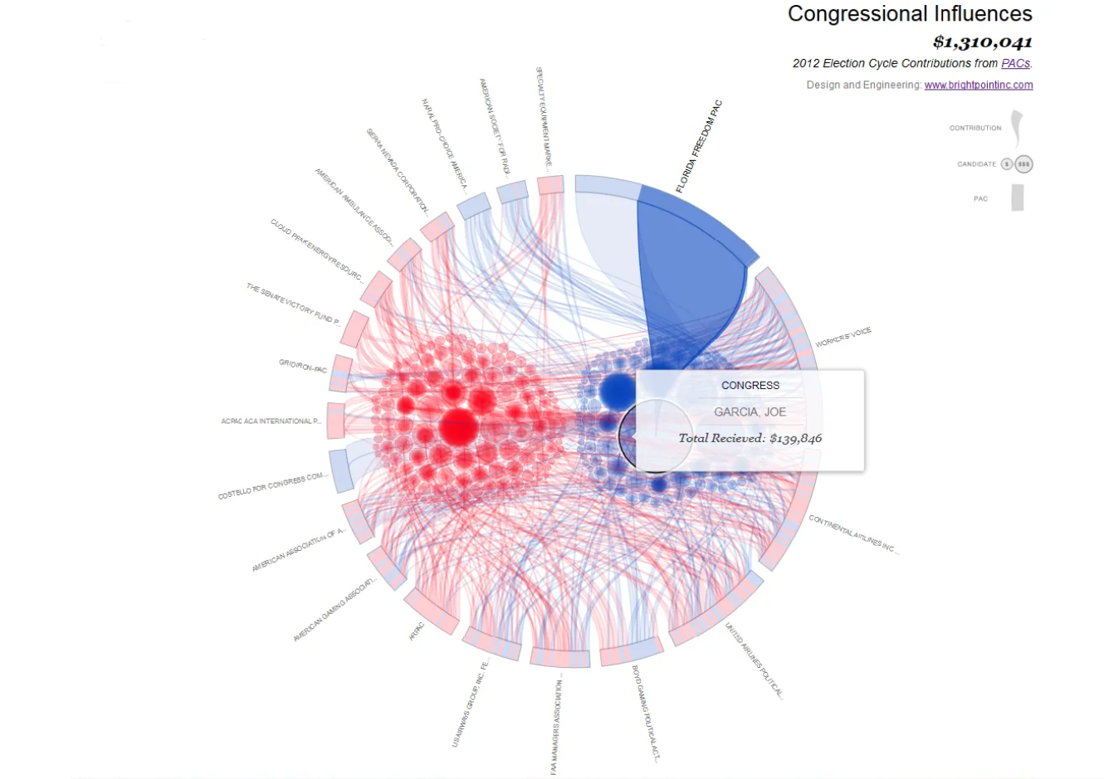
Data complexity
Some data can be too complex to be analyzed in 2D, independently of the screen space available.
Clustering and dimensionality reduction can be used along with focus + context tools like magic lenses to reduce data complexity.
For zoomed information spaces, offloading information to auxiliary devices to increase screen estate can be beneficial.

Slide 15
Multiple user support
Obstruction and distraction;
Personal territories.

Slide 16
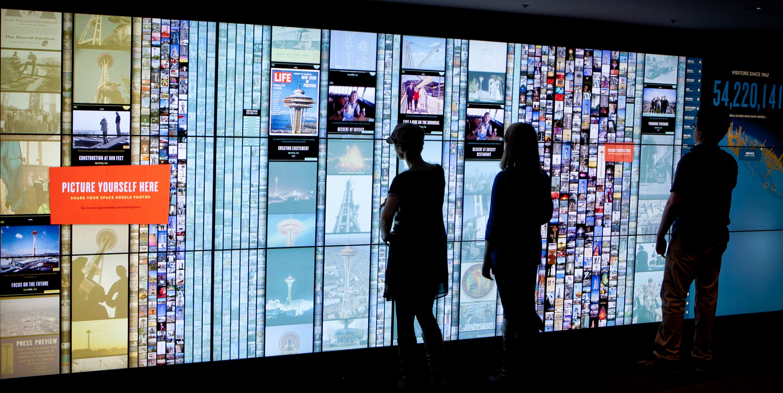
Obstruction and distraction
Large displays also have issues when it comes to multiple users.
The users will inevitably physically obstruct, disturb, and distract each other when working in groups.

Slide 17
Personal territories
Studies have shown that users value a personal territory to interact with while still maintaining shared spaces.
For large displays this can be achieved by having designated spaces on the display, though it can be limiting, or by using additional devices such as a smartphone to interact with the display.

Slide 18
proposition
To tackle the previous issues, the paper proposes the combined use of large displays with immersive analytics technologies.
Large displays + AR personal head mounted displays.

Slide 19
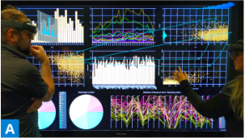
How it works
Multiple users interact independently with a common large display.
But each one chooses which parts to pay attention to, or interact with (through AR).

Slide 20
Designing The technology
Some decisions had to be made to decide how these technologies would interact with each other.

Slide 21
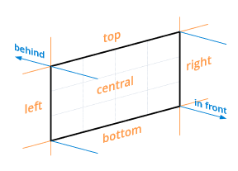
Spatial alignment of display and ar content
AR objects can be:
On or in front of the display;
Close or directly at the edge of the display;
No spatial relation to the display.
Use display’s screen as frame of reference.
Allows the display to be divided into 9 zones or more (3D).
Central zone is the most important.
Corners should be avoided.
The smaller the screen, the more important peripheral zones become and vice versa.

Slide 22
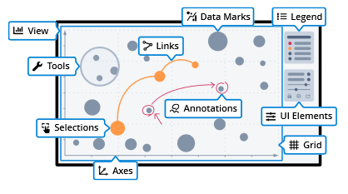
Augmentations for part of a visualization
Visualization components like axes, data marks and labels can be extended with AR techniques.
Can address overplotting and improve clarity by adding another dimension.
UI elements for interaction and tools can be offloaded to AR.
When the display is crowded with visualizations, these can be folded 90 degrees.

Slide 23
Personal views in multi user scenarios
Large displays can be used by multiple people at the same time.
AR HMDs allow for public views and personal views.
Content on the HMDs is individual but can be shared to foster collaboration.
But its overall better to keep HMDs content private:
Prevents obstruction;
Personalized views tailored to the user’s needs.
Private information.

Slide 24
Addressing perceptual issues
To address the problems we mentioned, 4 techniques were chosen.

Slide 25
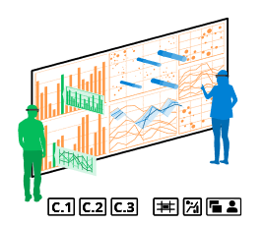
Embedded ar visualizations
Multiple coordinated visualizations are better at representing multivariate datasets than a single one.
But this can be associated with many context and focus switches.
One solution is to display additional data in AR space directly on the corresponding data objects of an existing visualization.
To ensure spatial connection embedded views can be adapted to the original form of the data marks they extend.

Slide 26
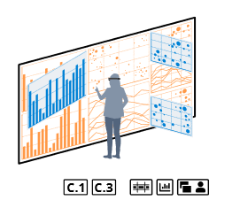
Hinged visualizations
Extreme viewing angles can cause distortion on large displays.
To promote awareness of remote parts of the display, visualizations can be hinged (like a door) to form a better angle with the user.
Visualizations at more extreme angles tilt more, where visualizations directly in front of the user don’t tilt at all.
As the user steps away from the screen, the visualizations flatten.

Slide 27
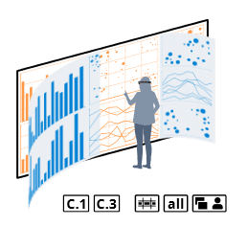
Curved ar screen
Addresses similar issues to the last one, but by curving the screen instead of hinging individual visualizations.
The whole screen curves except for the part immediately in front of the user.
The farther he is from an edge, the stronger the curve.
The screen also flattens as the user moves farther from the whole display.

Slide 28
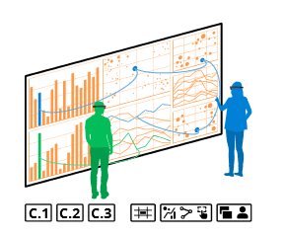
Ar brushing and linking
When selecting one or more items, connected items in different visualizations are often highlighted by brushing and linking.
In large displays this can be hard to perceive due to impaired color perception in the peripheral field of view and inability to track changes over long distances.
3D AR links like curves, can be used to improve connection and perception.
These links can also encode values (through color, height, shape,).

Slide 29
Addressing the management of density and complexity
Four techniques were proposed to make dense and complex data easier to experience.

Slide 30
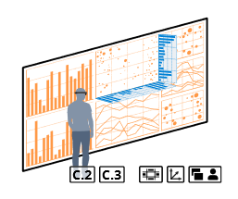
Extended axis views
Aggregations are an effective way to get a better overview and to find patterns in huge amounts of data.
Can be shown for specific data dimensions (axes) by providing a histogram (example) with the distribution of values along such axis.
To use screen space exclusively for core visualizations, this is moved to AR.
These views are presented directly on the axis of a visualization and expand to the corresponding spatial zone. To better understand which data is being aggregated.

Slide 31
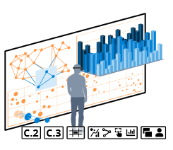
Ar visualization layers
Dense visualizations may result in overplotting and an unreadable visualization.
Large displays can reduce the amount of overlapping data marks, but for something like edge crossings in node-link diagrams, the problem remains.
The solution is to transfer some or all elements to AR in multiple layers.
Additionally, the layers can act as filters.
To avoid the obstruction of the original display, these layers are only shown on demand and with some degree of transparency.

Slide 32
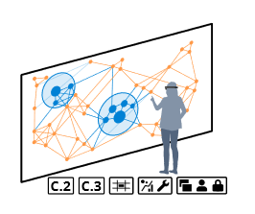
Magic ar lenses
Magic lenses can apply arbitrary filters to the underlying data.
These tools are good at reducing complexity and identifying patterns, but they take a lot of space and can obstruct other analysts’ view.
The lens is moved to AR as a personal tool, allowing each user to configure it however they see fit.
They can still be controlled and configured with touch on the display.
In AR these filters also benefit from a third dimension.

Slide 33
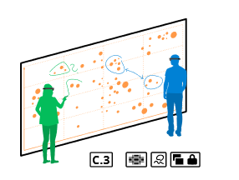
Ar annotations
It is often useful to make notes, drawings or sketches on the visualizations when analyzing data.
Notes are personal, an analyst’s notes can be irrelevant or even disturbing to others.
They may also want to keep them private.
Thus, annotations are created by using a digital pen on the display but are only displayed in AR space.

Slide 34
Framework
A framework had to be developed.
Most existing ones are limited to 2D and the others were either difficult to integrate or had compatibility issues.
u2vis was developed.
Fully developed with Unity 3D engine and C#.
Initially only supporting 2D and 3D bar charts, line graphs, scatter plots, parallel coordinates and pie charts. But easily extensible.
Client server application using TCP and Open Sound Control to synchronize display and HMD.

Slide 35
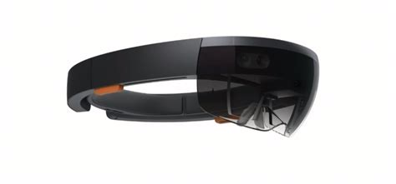
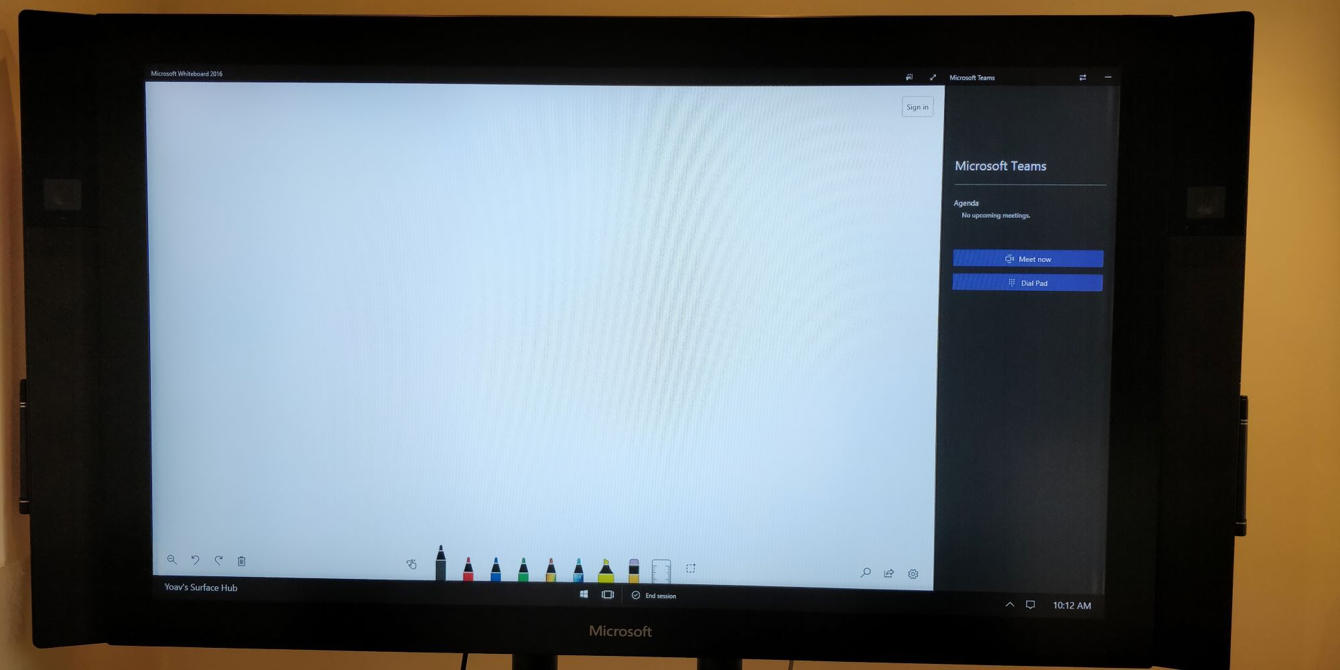
prototype
With the framework complete, the previous techniques were implemented.
To ensure spatial alignment between HMD and display, all AR content has an anchor on the lower left corner of the screen.
Touch input is the main way of interacting with the displays.
Digital pen can be used to create personal annotations.
For the prototype:
Microsoft Surface Hub.
MS HoloLens 1 (HMD)

Slide 36
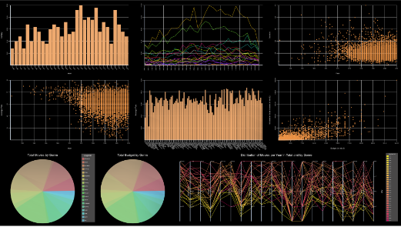
Use case
To examine performance cognitive walkthrough was done based on well established analysis tasks.
The prototype was used exposing visualizations of a large dataset regarding movies and the subjects “Sue” and “Matt” were put to the test of analysis and exploration tasks.

Slide 37
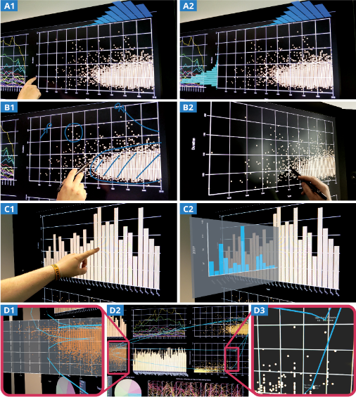
Some interactions during the tasks
A1-A2 extended axis view
B1-B2 personal annotations
C1-C2 embedded AR visualizations
D1-D3 brushing and linking and hinged visualizations

Slide 38
conclusions
The cognitive walkthrough showed that this setup supports common analysis tasks and even has some advantages:
Saving valuable screen space.
Integrating additional information directly in place.
Not obstructing other analysts.
Thus we conclude that such mixed reality approaches show a lot of potential in the field of information visualization and should be further explored.

Slide 39
The end
Any questions?

